Slide 1
Dish TV India Limited
Earnings Presentation
Quarter Ended December 31, 2025
Stock Code: BSE - 532839 NSE- DISHTV LSE: DTVL

Slide 2
Disclaimer
Some of the statements made in this presentation are forward-looking statements and are based on the current beliefs, assumptions, expectations, estimates, objectives and projections of the directors and management of Dish TV India Limited about its business and the industry and markets in which it operates.
These forward-looking statements include, without limitation, statements relating to revenues and earnings. The words “believe”, “anticipate”, “expect”, “estimate", "intend”, “project” and similar expressions are also intended to identify forward looking statements. These statements are not guarantees of future performance and are subject to risks, uncertainties and other factors, some of which are beyond the control of the Company and are difficult to predict.
Consequently, actual results could differ materially from those expressed or forecast in the forward-looking statements as a result of, among other factors, changes in economic and market conditions, changes in the regulatory environment and other business and operational risks. Dish TV India Limited does not undertake to update these forward-looking statements to reflect events or circumstances that may arise after publication.

Slide 3
Key highlights for the quarter

Slide 4
Key financial highlights
Operating Revenues
Operating revenues for the quarter were Rs. 2,991 million
EBITDA
EBITDA of Rs. (415) million
EBITDA Margin
EBITDA margin at (13.9)%
Debt
Maintained debt-free status as on December 31, 2025

Slide 5
Business Highlights/ Key Developements
Strategic Progress: Building a Hybrid Entertainment Ecosystem
Expanded VZY Smart TVs nationwide, offering a unified DTH + OTT experience.
Integrated Amazon Prime Video across DishTV, Watcho, and VZY Smart TVs.
Scaled Watcho Super App with millions of downloads and paid subscribers, supported by 25+ content apps.
Strengthened FLIQS as a creator-driven platform for premium regional and international content.
Enhanced brand visibility through high-profile partnerships with Bigg Boss Hindi and Bigg Boss Kannada.

Slide 6
Business Outlook
Strategic priorities
Expand connected footprint: Drive new activations through a market‑leading, no‑subsidy ₹999 set‑top box to broaden reach while protecting margins.
Scale digital and OTT: Position Watcho as a core growth engine by prioritizing product innovation, deeper engagement, and diversified monetization.
Hybrid monetization: Blend subscription, advertising, and platform revenue to increase ARPU and reduce single‑channel dependency.
Content partnerships: Secure strategic content alliances to enhance offering and optimize content spend.
Operational progress
Improving asset discipline: Box recovery beyond 30 days is trending up, reducing swap frequency and limiting replacement capex.
Cost optimization: Renegotiated transponder contracts and active expense rationalization across call centers and G&A are delivering meaningful savings.
Customer focus: Churn remains a priority; we are intensifying retention programs and lifecycle engagement to stabilize recurring revenue.

Slide 7
Business Outlook- Continued..
Financial implications
Margin improvement: Eliminating subsidies on new activations and the ₹999 pricing materially improves unit economics on customer additions.
Cash flow uplift: Transponder savings and overhead rationalization will enhance near‑term cash generation.
Capex discipline: Better box recovery and lower swap costs reduce incremental capital requirements and support disciplined capital allocation.
Risks and execution priorities
Retention risk: Sustained focus on reducing churn is essential to convert operational gains into durable revenue growth.
Execution intensity: Scaling Watcho and realizing hybrid monetization require targeted investment and rigorous KPI tracking.
Service continuity: Cost rationalization must preserve customer experience and service levels to avoid undermining retention.

Slide 8
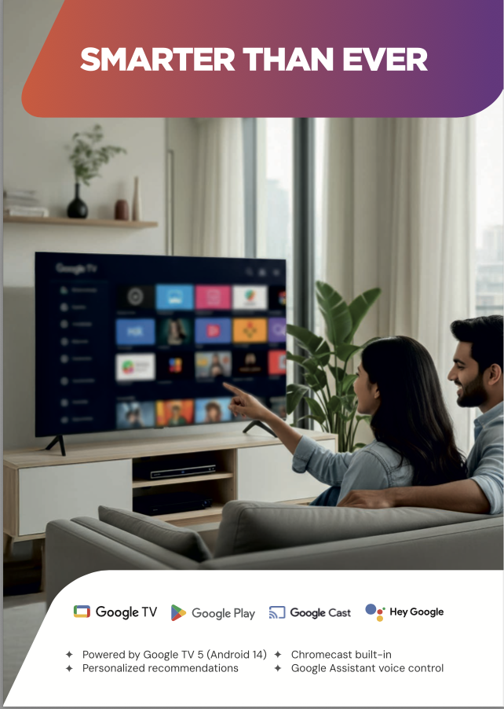




VZY TV - Launch

Slide 9
VZY TV – Launch/ Connected TV’s growth forecast
Biggest Play : Connected TV’s
2023
137
19
Smart TV penetration estimated to grow to 100 MN
Hybrid consumption and Bundling opportunities with OTT and broadband
2026
153
40
2030
183
100
Pay TV +Smart TV
Smart TV
PAY TV GROWTH WILL BE LIMITED
However, with smart TVs and wired / air broadband
Next 5 years : The world of CTV’s

Slide 10
VZY TV –Market Opportunities
- TV viewing remains central to family consumption. Immersive content (Sports) still favors TV.
- Large FTA / SD cable base and rural markets represent a major conversion opportunity.
- Smart TV shipments in India (~2024) are large — meaningful new device-led acquisition.
- Growing digital ad & subscription markets create diversified monetization paths.
Long runway where linear TV and connected TV coexist — Dish TV has the bridge.

Slide 11
Dish TV maintains debt-free status

Slide 12





Watcho - OTT aggregation

Slide 13
Watcho - Downloads so far

Slide 14
3Q FY26 Financials

Slide 15
Quarterly performance metrics
P&L structure – 3Q FY26
Subscription revenues
Rs. 2,245 million
Operating revenues
Rs. 2,991 million
EBITDA
Rs. (415) million
EBITDA Margin
(13.9)%
EBITDA margin – (13.9)%

Slide 16
Summarized consolidated P&L - Quarterly
 |  | Quarter ended | Quarter ended
Rs. million |  | December 2025 | December 2024
Operating revenues |  | 2,991 | 3,730
Expenditure |  | 3,406 | 2,503
EBITDA |  | (415) | 1,227
EBITDA margin (%) |  | (13.9) | 32.9
Other income |  | 57 | 90
Depreciation and amortization |  | 1020 | 1,072
Finance cost |  | 684 | 711
Exceptional items |  | 700 | -
Profit / (Loss) before tax |  | (2,762) | (465)
Tax expense:
- Current Tax |  | - | -
- Deferred Tax |  | - | -
Net Profit / (Loss) for the period |  | (2,762) | (465)
Operating revenues break-up (Rs. Mn.)
3Q FY2026
Note: 1) Numbers in the table may not add up due to rounding-off. 2) Previous year figures have been regrouped wherever necessary.

Slide 17
FY25 Financials

Slide 18
Annual performance metrics
Subscription revenues
Rs. 13,771 million
P&L structure – FY25
Operating revenues
Rs. 15,676 million
EBITDA
Rs. 5,291 million
EBITDA Margin
33.8%
EBITDA margin – 33.8%

Slide 19
Summarized consolidated P&L- Annual
 |  | Year ended | Year ended
Rs. million |  | March 2025 | March 2024
Operating revenues |  | 15,676 | 18,565
Expenditure |  | 10,385 | 11,028
EBITDA |  | 5,291 | 7,537
EBITDA margin (%) |  | 33.8 | 40.6
Other income |  | 264 | 193
Depreciation |  | 4,391 | 4,719
Financial expenses |  | 2,687 | 2,670
Exceptional items |  | 3,354 | 4,027
Profit / (Loss) before tax |  | (4,877) | (3,686)
Current Tax Deferred Tax |  |  | - (15,979)
Net Profit / (Loss) for the period |  | (4,877) | (19,666)
Operating revenues break-up (Rs. mn.)
FY 2025
Note: 1) Numbers in the table may not add up due to rounding-off. 2) Previous year figures have been regrouped wherever necessary.

Slide 20
Consolidated balance sheet
Rs. million | March 2025 (Audited)
Equity and liabilities
Equity
(a) Equity share capital | 1,841
(b) Other equity | (34,271)
(c) Non-controlling interest | (1)
Liabilities (1) Non-current liabilities (a) Financial liabilities
(i) Borrowings | -
(ii) Lease liabilities | 192
(iii) Other financial liabilities | -
(b) Provisions | 17
(c) Other non-current liabilities | -
(2) Current liabilities (a) Financial liabilities
(i) Borrowings | -
(ii) Trade payables
Total outstanding dues of micro enterprises and small enterprises | 18
Total outstanding dues of creditors other than micro & small enterprises | 4,126
(iii) Lease liabilities | 155
(iv) Other financial liabilities | 585
(b) Other current liabilities | 3,410
(c) Provisions | 46,966
(d) Current tax liabilities (Net) | -
Total equity & liabilities | 23,038

Slide 21
Rs. million | March 2025 (Audited)
Assets
(1) Non-current assets
(a) Property, plant & equipment | 10,368
(b) Capital work in progress | 2,914
(c) Goodwill | 1
(d) Other intangible assets | 32
(e) Intangible assets under development | 605
(f) Financial assets (i) Investments | -
(ii) Loans | -
(iii) Other financial assets | 65
(g) Deferred tax assets (net) | -
(h) Current tax assets (net) | 1,008
(i) Other non-current assets | 1,298
(2) Current assets (a) Inventories | 90
(b) Financial assets (i) Investments (ii) Trade receivables (iii) Cash and cash equivalents (iv) Other bank balances (v) Other financial assets (c) Other current assets | 250 795 359 1,245 77 3,931
Total assets | 23,038

Slide 22
Thank you

