Slide 1
Dish TV India Limited
Earnings Presentation
Year & Quarter Ended March 31, 2026
Stock Code: BSE - 532839 NSE- DISHTV LSE: DTVL

Slide 2
Disclaimer
Some of the statements made in this presentation are forward-looking statements and are based on the current beliefs, assumptions, expectations, estimates, objectives and projections of the directors and management of Dish TV India Limited about its business and the industry and markets in which it operates.
These forward-looking statements include, without limitation, statements relating to revenues and earnings. The words “believe”, “anticipate”, “expect”, “estimate", "intend”, “project” and similar expressions are also intended to identify forward looking statements. These statements are not guarantees of future performance and are subject to risks, uncertainties and other factors, some of which are beyond the control of the Company and are difficult to predict.
Consequently, actual results could differ materially from those expressed or forecast in the forward-looking statements as a result of, among other factors, changes in economic and market conditions, changes in the regulatory environment and other business and operational risks. Dish TV India Limited does not undertake to update these forward-looking statements to reflect events or circumstances that may arise after publication.

Slide 3
Key highlights for the quarter

Slide 4
Key financial highlights
Operating Revenues
Operating revenues for the quarter were Rs. 2,431 million
EBITDA
EBITDA of Rs. (700) million
EBITDA
Margin
EBITDA margin at (28.8)%
Debt
Maintained debt-free status as on March 31, 2026

Slide 5
Business Highlights/ Key Developements
Strategic Progress: Continues Strategic Progress Across
Connected Entertainment Ecosystem
Continued strategic transition towards a hybrid entertainment ecosystem spanning DTH, OTT aggregation, connected devices, and Smart TV experiences.
Expanded the VZY Smart TV portfolio to strengthen presence in the connected entertainment segment.
VZY Smart TV sales crossed the ₹100 crore milestone, marking continued growth in Dish TV’s connected entertainment business.
Continued integration of DTH and OTT services within a unified entertainment ecosystem.
Advanced diversification strategy focused on increasing contribution from non-DTH businesses over the next 18–24 months.
Successfully concluded Content India 2026 in partnership with C21Media, bringing together 700+ delegates from broadcasters, OTT platforms, studios, producers, creators, and global media companies. Strengthened industry positioning through discussions around AI-led storytelling, monetisation models, co-production opportunities, and the future of entertainment consumption.
Continued consumer engagement initiatives through the integrated ‘Always-On’ campaign focused on seamless and uninterrupted entertainment experiences.

Slide 6
Business Outlook
Dish TV India remains focused on:
Accelerating transition towards a connected entertainment ecosystem
Expanding VZY Smart TV and connected device presence
Strengthening OTT aggregation and hybrid viewing capabilities
Enhancing consumer engagement and retention initiatives
Driving operational efficiencies and revenue diversification
Increasing contribution from non-DTH and connected entertainment businesses
The Company continues to navigate a dynamic operating environment characterised by evolving consumer behaviour, increasing digital competition, inflationary pressures, and technology transition risks, while remaining focused on disciplined execution and long-term value creation.

Slide 7
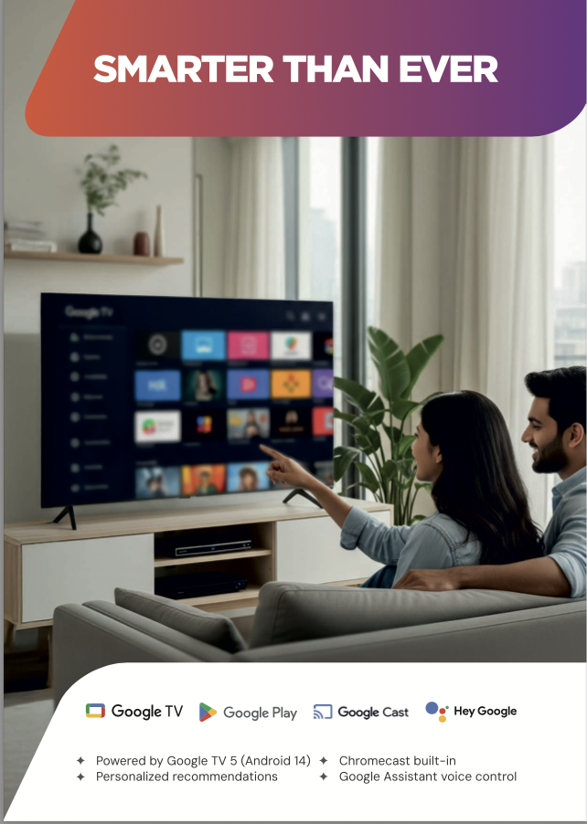




VZY TV - Launch

Slide 8
VZY TV – Launch/ Connected TV’s growth forecast
Biggest Play : Connected TV’s
2023
137
19
Smart TV penetration estimated to grow to 100 MN
Hybrid consumption and Bundling opportunities with OTT and broadband
2026
153
40
2030
183
100
Pay TV +Smart TV
Smart TV
PAY TV GROWTH WILL BE LIMITED
However, with smart TVs and wired / air broadband
Next 5 years : The world of CTV’s

Slide 9
VZY TV –Market Opportunities
- TV viewing remains central to family consumption. Immersive content (Sports) still favors TV.
- Large FTA / SD cable base and rural markets represent a major conversion opportunity.
- Smart TV shipments in India (~2024) are large — meaningful new device-led acquisition.
- Growing digital ad & subscription markets create diversified monetization paths.
Long runway where linear TV and connected TV coexist — Dish TV has the bridge.

Slide 10
Dish TV maintains debt-free status

Slide 11





Watcho - OTT aggregation

Slide 12
Watcho - Downloads so far

Slide 13
4Q FY26 Financials

Slide 14
Quarterly performance metrics
P&L structure – 4Q FY26
Subscription revenues
Rs. 1,563 million
Operating revenues
Rs. 2,431 million
EBITDA
Rs. (700) million
EBITDA Margin
(28.8)%
EBITDA margin – (28.8)%

Slide 15
Summarized consolidated P&L - Quarterly
 |  | Quarter ended | Quarter ended
Rs. million |  | March 2026 | March 2025
Operating revenues |  | 2,431 | 3,437
Expenditure |  | 3,131 | 2,463
EBITDA |  | (700) | 973
EBITDA margin (%) |  | (28.8) | 28.3
Other income |  | 108 | 67
Depreciation and amortization |  | 1,030 | 1,064
Finance cost |  | 683 | 644
Exceptional items |  | 735 | 3,354
Profit / (Loss) before tax |  | (3,039) | (4,022)
Tax expense:
- Current Tax |  | - | -
- Deferred Tax |  | - | -
Net Profit / (Loss) for the period |  | (3,039) | (4,022)
Operating revenues break-up (Rs. Mn.)
4Q FY2026
Note: 1) Numbers in the table may not add up due to rounding-off. 2) Previous year figures have been regrouped wherever necessary.

Slide 16
FY26 Financials

Slide 17
Annual performance metrics
Subscription revenues
Rs. 8,863 million
P&L structure – FY26
Operating revenues
Rs. 11,626 million
EBITDA
Rs. (69) million
EBITDA Margin
(0.59)%
EBITDA margin – (0.59)%

Slide 18
Summarized consolidated P&L- Annual
 |  | Year ended | Year ended
Rs. million |  | March 2026 | March 2025
Operating revenues |  | 11,626 | 15,676
Expenditure |  | 11,695 | 10,385
EBITDA |  | (69) | 5,291
EBITDA margin (%) |  | (0.59) | 33.8
Other income |  | 294 | 264
Depreciation |  | 4,139 | 4,391
Financial Cost |  | 2,698 | 2,687
Exceptional items |  | 1,435 | 3,354
Profit / (Loss) before tax |  | (8046) | (4,877)
Current Tax- Prior years Deferred Tax |  | 27
Net Profit / (Loss) for the period |  | (8074) | (4,877)
Operating revenues break-up (Rs. mn.)
FY 2026
Note: 1) Numbers in the table may not add up due to rounding-off. 2) Previous year figures have been regrouped wherever necessary.

Slide 19
Consolidated balance sheet
Rs. million | March 2026 (Audited)
Equity and liabilities
Equity
(a) Equity share capital | 1,841
(b) Other equity | (42,267)
(c) Non-controlling interest | (1)
Liabilities (1) Non-current liabilities (a) Financial liabilities
(i) Borrowings | -
(ii) Lease liabilities | 120
(iii) Other financial liabilities | -
(b) Provisions | -
(c) Other non-current liabilities | -
(2) Current liabilities (a) Financial liabilities
(i) Borrowings | -
(ii) Trade payables
Total outstanding dues of micro enterprises and small enterprises | 164
Total outstanding dues of creditors other than micro & small enterprises | 3,944
(iii) Lease liabilities | 187
(iv) Other financial liabilities | 664
(b) Other current liabilities | 3,389
(c) Provisions | 49,488
(d) Current tax liabilities (Net) | -
Total equity & liabilities | 17,529

Slide 20
Rs. million | March 2026 (Audited)
Assets
(1) Non-current assets
(a) Property, plant & equipment | 8,705
(b) Capital work in progress | 1,441
(c) Goodwill | 1
(d) Other intangible assets | 27
(e) Intangible assets under development | 605
(f) Financial assets (i) Investments | -
(ii) Loans | -
(iii) Other financial assets | 33
(g) Deferred tax assets (net) | -
(h) Current tax assets (net) | 714
(i) Other non-current assets | 1,252
(2) Current assets (a) Inventories | 229
(b) Financial assets (i) Investments (ii) Trade receivables (iii) Cash and cash equivalents (iv) Other bank balances (v) Other financial assets (c) Other current assets | 116 645 272 1,193 94 2,204
Total assets | 17,529

Slide 21
Thank you

